Slide 1
“Political Parties”

Slide 2
Development of Political Parties
A political party is a group of citizens (voters) with similar views on public issues who work to put their ideas into effect through government action and who band together to elect candidates.

Slide 3
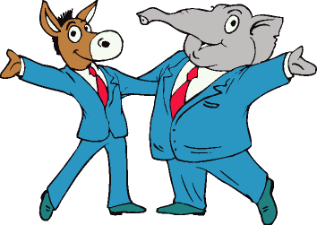
Development of Political Parties
Parties pick candidates who agree with their beliefs and try to persuade voters to support their candidates who are running for office.
The United States today has a two-party system, which means that we have two main political parties.

Slide 4
Political Spectrum
Generally, parties are often labeled as “liberal” or “conservative,” depending on their views.
Parties fall somewhere on the political spectrum (a range referring to differences in political views).
Most people fall somewhere in the middle and are known as “moderates.” They generally lean toward one side or the other.
Left Moderate Right
“Liberal”
“Conservative”

Slide 5
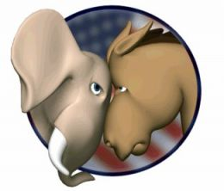
Today’s Major Parties
A basic difference between the major parties is their belief in how much the government should be involved in the lives of Americans.

Slide 6
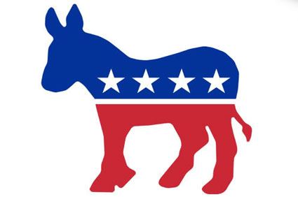
Democratic Party
Democrats are generally said to be more liberal.
They favor more government programs that offer services in housing, education, healthcare, and economics.
These programs would be funded through taxes.

Slide 7
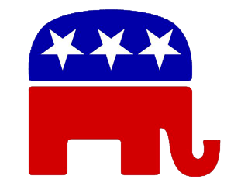
Today’s Major Parties
Republicans are generally said to be more conservative.
Republicans tend to believe that they can help the nation’s economy grow by reducing the amount of taxes that people have to pay.
They favor less government regulation of the economy.
They are opposed to raising taxes.

Slide 8
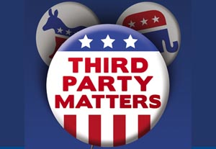
Third Parties
Although they sometimes challenge the two major parties, a Third Party has never won a Presidential election and has rarely won any other major elections.

Slide 9
Third Parties
Third Parties, however, can affect the outcome of elections and may also influence government policy.

Slide 10
Third Parties
Third Parties rarely win major elections because of the two-party tradition.
For example, while the names of Republican and Democratic candidates are automatically placed on the ballot, Third-Party candidates must obtain a large number of signatures to get on the ballot.

Slide 11
Examples of Third Parties
The Communist Party supports the rights of the workers and economic equality.

Slide 12
Examples of Third Parties
The Socialist Party supports government ownership/allocation of resources.

Slide 13
Examples of Third Parties
The Libertarian Party would like to increase individual freedoms by cutting the size of the U.S. government.
According to the Libertarian party, they are “more liberal than Democrats, yet more conservative than Republicans.”

Slide 14
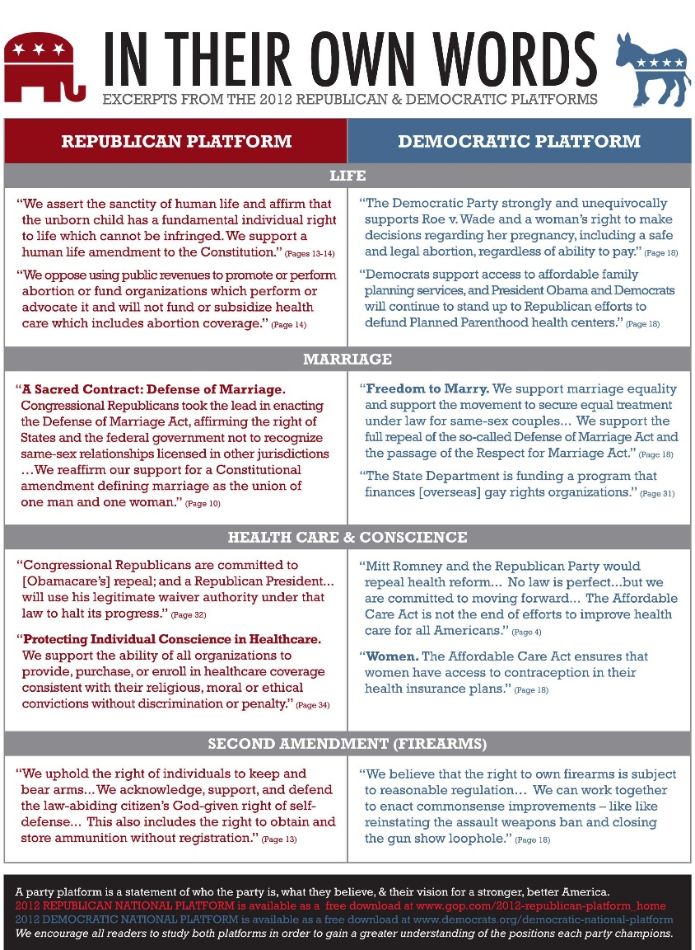
Party Platforms
To know where a party stands on the major issues, voters can look at the party’s platform.

Slide 15
Party Platforms
A platform is a series of statements expressing the party’s principles, beliefs, and positions on issues.
Each individual part of a platform is called a plank.

Slide 16
The Issues – Federal
 | Platform (Overall Party Concerns) | Democratic Party Platform | Republican Party Platform
Plank 1 (Specific Issue) | Unites States Economy | Wants the federal government to place regulations on businesses to influence economic growth | Wants to use tax relief to grow economy and create jobs
Plank 2 (Specific Issue) | Education | Wants to raise standards in K-12 Schools and increase financial aid for secondary education | Wants to increase access to charter schools, and promote accountability for students and parents
Plank 3 (Specific Issue) | Health Care | Mandated healthcare for all citizens | Says mandated healthcare is unconstitutional. Supports Medicare
Plank 4 (Specific Issue) | Energy | Supports industry of creating green energy | Wants America to resume off-shore drilling to boost economy and lower energy costs

Slide 17
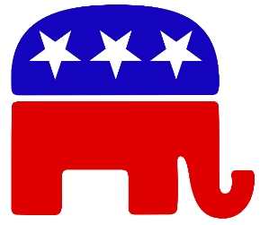
Where do they stand on the Economy, Heath Care, Environment, Education???

